Slide 1
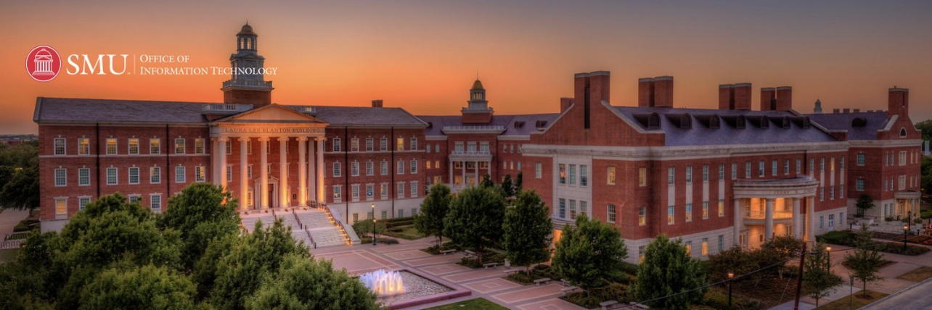
WORKSHOP
INTRODUCTION TO DEEP LEARNING
Tue Vu, PhD
Research & Data Science Services
SMU OIT
Notes:
Idea follow Vblog: machinelearningcoban and Deep Learning 101
Machine Learning cơ bản (machinelearningcoban.com)
Deep Learning 101 - Part 1: History and Background (beamandrew.github.io)

Slide 2

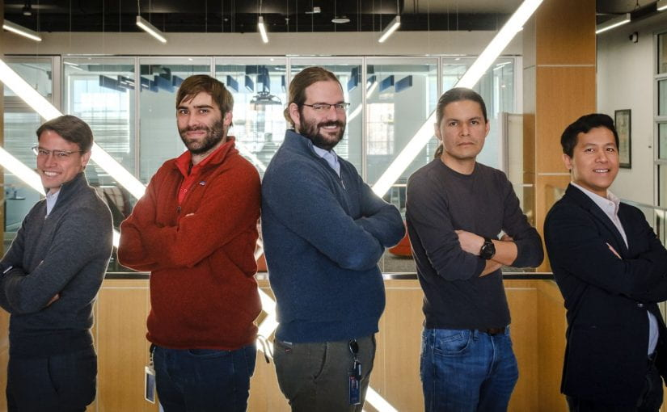
Research & Data Science Service
Who we are?

Slide 3
Research & Data Science Service
What we do?
Onboard students and researchers with High Performance Computing using M2 (and other HPC)
Consultation and Scale up research to a new level
Data analytics, Data Sciences services
Application of Machine Learning & Deep Learning to advance research
Conduct workshop on Advance Research Computing and Data Science to SMU communities
Internet of Things (IOT)

Slide 4
WORKSHOP
INTRODUCTION TO DEEP LEARNING
Tue Vu, PhD
Research & Data Science Services
SMU OIT
Notes:
Idea follow Vblog: machinelearningcoban and Deep Learning 101
Machine Learning cơ bản (machinelearningcoban.com)
Deep Learning 101 - Part 1: History and Background (beamandrew.github.io)

Slide 5
Schedule
Introduction
History of Deep Learning
Applications of Deep Learning
Deep Learning Framework
Recap with Neural Network
Introduction to Keras API
Hands-on section

Slide 6
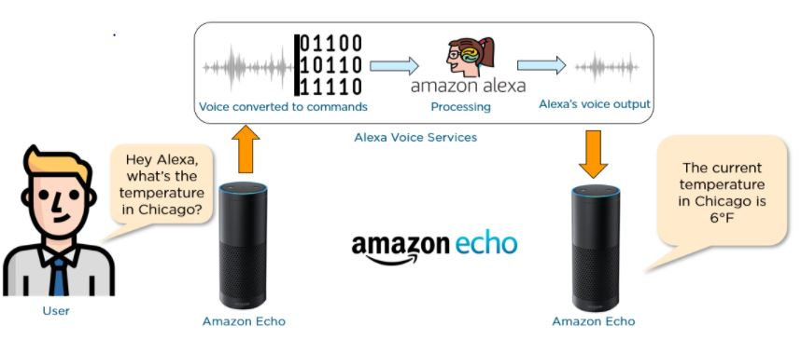
Introduction
https://www.kaggle.com/general/205301
Notes:
AI ML is in our everyday life, even in your room: Alexa.

Slide 7
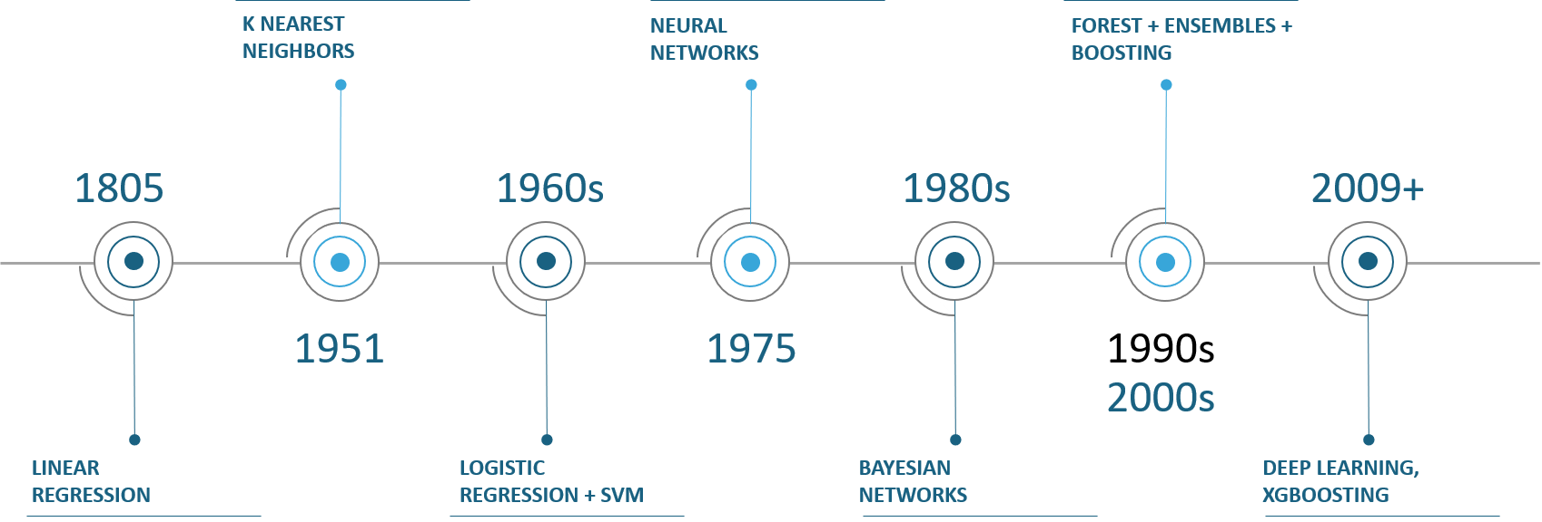
Introduction
Machine Learning Timeline:
Notes:
Machine Learning enables computers to learn from data with minimal programming.
Neural Network is a type of machine learning that is made up of interconnected units that processes information by responding to external inputs, relaying information between each unit.
Deep Learning is a type of machine learning that uses neural networks with many layers of processing units.

Slide 8
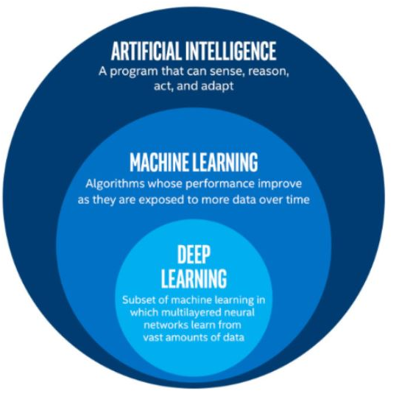
Introduction
Notes:
AI ML is in our everyday life, even in your room: Alexa.
Here is the overall relationship between AI, ML and DL and the corresponding time stamp.

Slide 9
Introduction
HPC
GPU
TPU
Notes:
AI ML is in our everyday life, even in your room: Alexa.
Here is the overall relationship between AI, ML and DL and the corresponding time stamp.

Slide 10
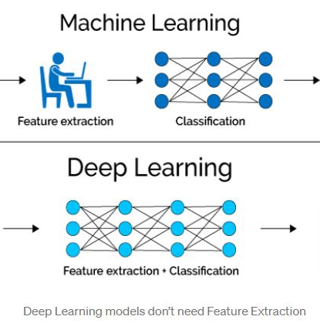
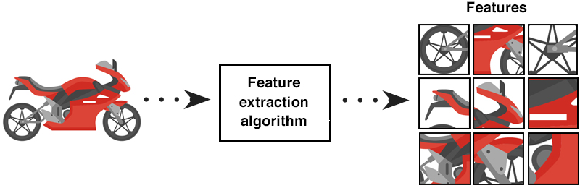
Introduction
Bike
Not Bike
Input
Output
Bike
Not Bike
Input
Output
Notes:
The first advantage of Deep Learning over machine learning is the needlessness of Feature Extraction.
Traditional machine learning methods like Decision Trees, SVM, Naïve Bayes Classifier and Logistic Regression can’t be applied directly to the raw data (such as .csv, images, text, etc.) but requires Feature Extraction. The result of Feature Extraction is an abstract representation of the given raw data that can now be used by these classic machine learning algorithms. Feature Extraction is usually complicated and requires detailed knowledge of the problem domain. This step must be adapted, tested and refined over several iterations for optimal results.
Neural networks do not require feature extraction because the layers can learn an implicit representation of the raw data directly on their own. A more and more abstract representation of the raw data is produced over several layers to be used to produce the result with automatic optimization for the best possible abstract representation of the input data with no manual effort to perform and optimize the feature extraction process.

Slide 11
Introduction
Has wheel | Yes
Weight | 3000 lbs
Has door | Yes
Using gas? | No
Bike
Not Bike
Input
Output
Bike
Not Bike
Input
Output
Notes:
The first advantage of Deep Learning over machine learning is the needlessness of Feature Extraction.
Traditional machine learning methods like Decision Trees, SVM, Naïve Bayes Classifier and Logistic Regression can’t be applied directly to the raw data (such as .csv, images, text, etc.) but requires Feature Extraction. The result of Feature Extraction is an abstract representation of the given raw data that can now be used by these classic machine learning algorithms. Feature Extraction is usually complicated and requires detailed knowledge of the problem domain. This step must be adapted, tested and refined over several iterations for optimal results.
Neural networks do not require feature extraction because the layers can learn an implicit representation of the raw data directly on their own. A more and more abstract representation of the raw data is produced over several layers to be used to produce the result with automatic optimization for the best possible abstract representation of the input data with no manual effort to perform and optimize the feature extraction process.

Slide 12
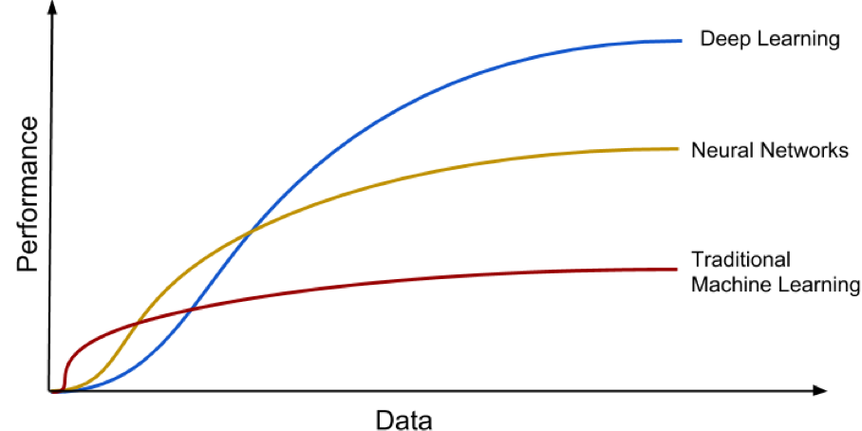
Introduction

Slide 13
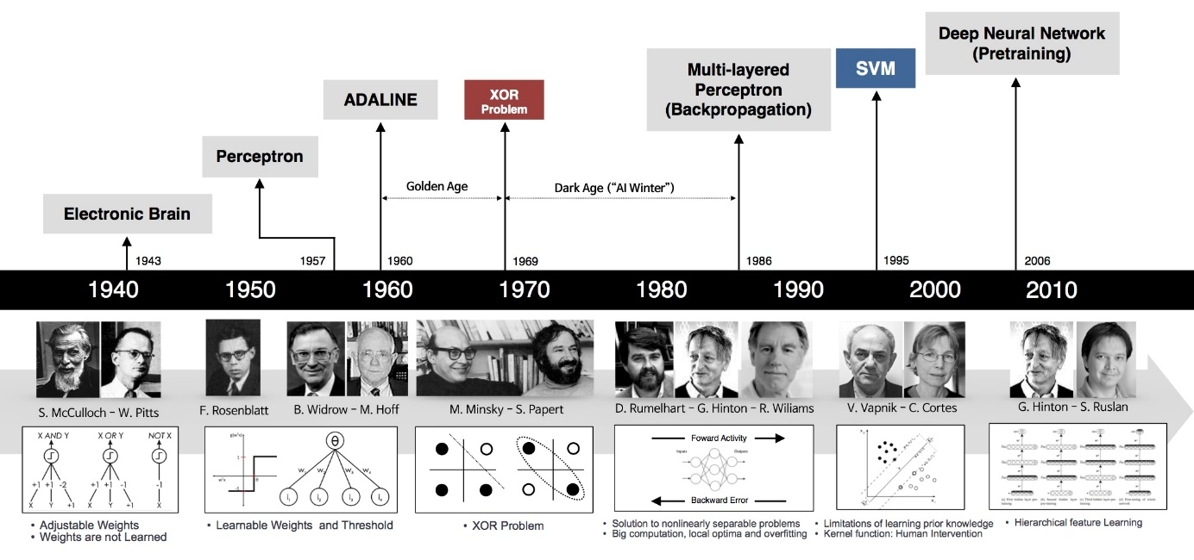
History of Deep Learning
http://beamandrew.github.io/deeplearning/2017/02/23/deep_learning_101_part1.html
Notes:
Idea follow Vblog: machinelearningcoban and Deep Learning 101
Machine Learning cơ bản (machinelearningcoban.com)
Deep Learning 101 - Part 1: History and Background (beamandrew.github.io)

Slide 14
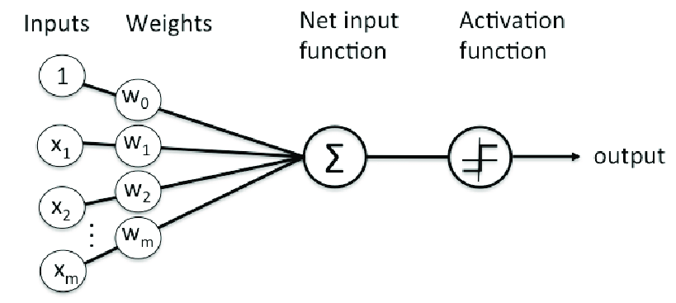
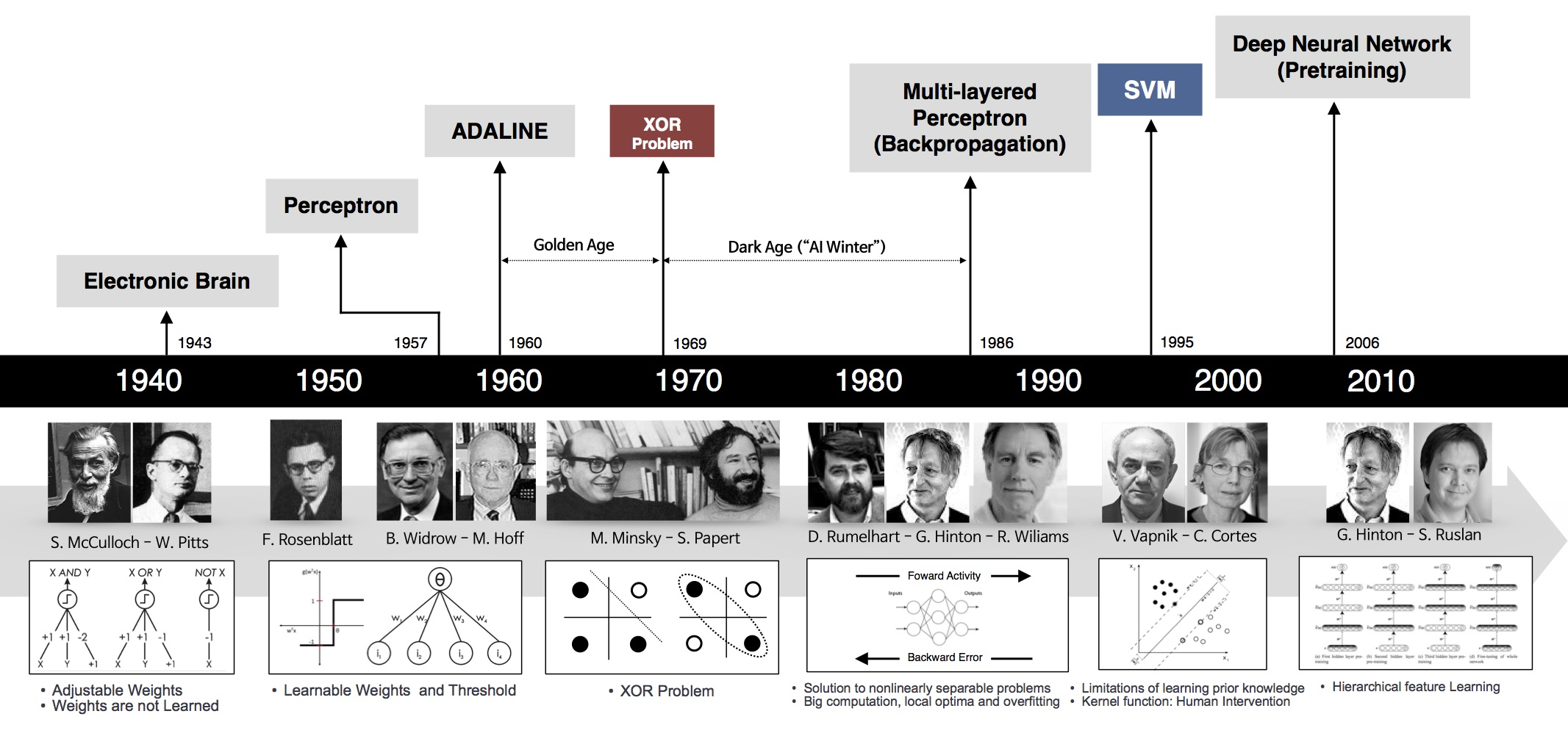
1957-1958: PERCEPTRON
Perceptron is one of the very first base of DL.
It was developed by Rosenblatt in 1957 (funded by US Naval Research)
It is a supervised learning model and applicable if the 2 datasets are linearly separable
Organization of Perceptron (Rosenblatt, 1958)
1958: [The perceptron is] the embryo of an electronic computer that [the Navy] expects will be able to walk, talk, see, write, reproduce itself and be conscious of its existence. (New York Times)
Notes:
- Perceptron Learning Algorithm (or Perceptron) is one of the first base of NN and DL.
It was developed by Rosenblatt in 1957 in a research funded by US Naval Research
It is a supervised learning model and applicable if the 2 datasets are linearly separable

Slide 15
However, I started to worry about what such a machine could not do. For example, it could tell ‘E’s from ‘F’s, and ‘5’s from ‘6’s—things like that. But when there were disturbing stimuli near these figures that weren’t correlated with them the recognition was destroyed.
1969: The First AI WINTER
Perceptron gains a decade of attention until Marvin Minsky – often thought of as one of the father of AI, sensed something off:
In a book named “Perceptron”, Minsky and Seymour Papert proved that perceptron was incapable of learning the simple exclusive-or (XOR) function (Now it is obvious that Perceptron is a linear model while XOR is non-linear)
This finding shocked the AI community and Perceptron was interrupted for 20 years, all research related Perceptron was halt.

Slide 16
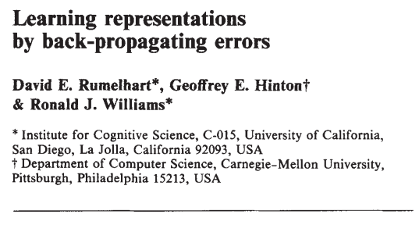
1986: The BACKPROPAGANDISTS emerge
Geoffrey Hinton (PhD in Neural Science) published in Nature: “Learning representations by back-propagating errors”.
The authors showed that NN with many hidden layers (Multi-Layer Perceptron - MLP) could be effectively trained by a relatively simple procedure called “Backpropagation”.
This allows NN to overcome the Perceptron’s weakness with the ability to learn nonlinear function (with nonlinear activation function like sigmoid, ReLU)
NN has ability as “universal approximation theorem” and it gets back to the race
Notes:
Backpropagation is another name of chain rule in calculating gradient

Slide 17
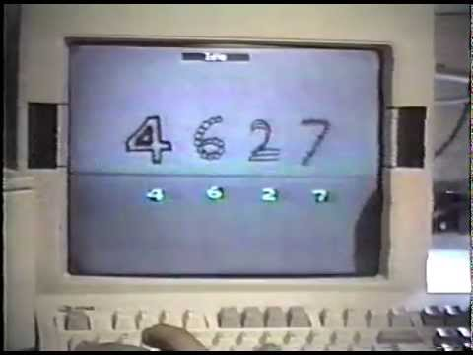
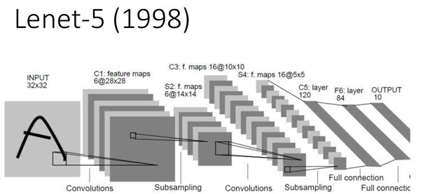
1986: CNN - LeNet
Backpropagation leads to some early success (notably Convolution Neural Network: CNN)
CNN was spearheaded by Yann LeCun at ATT Bell Labs to recognize handwritten digits.
This model has been used widely in US Banks and Post Office to read handwritten check and postal code
LeNet was the best algorithm at that time. It is better than regular MLP (with fully connected layers) with the ability to filter in 2D

Slide 18
1990-2000: The 2nd AI Winter (Deep Freeze)
Several disadvantage of CNN and MLP:
Limited in 2D data (images) for training (digital camera was not popular since then)
The ability of computation machine still limited
The NN were trained using stochastic gradient descent that made it difficult to optimize with less data and power
Many hidden layers with activation function led to vanishing gradient
That leads to the Deep Freeze of NN in this decade.
Support Vector Machine emerged during this time with kernel technology to find the optimal parameters
NN went back to storage and researchers started to move to SVM, except few stubborn researcher …
Notes:
Neural networks are trained using stochastic gradient descent.
Vanishing gradient means the gradient of loss function very close to zero and make model difficult to train

Slide 19
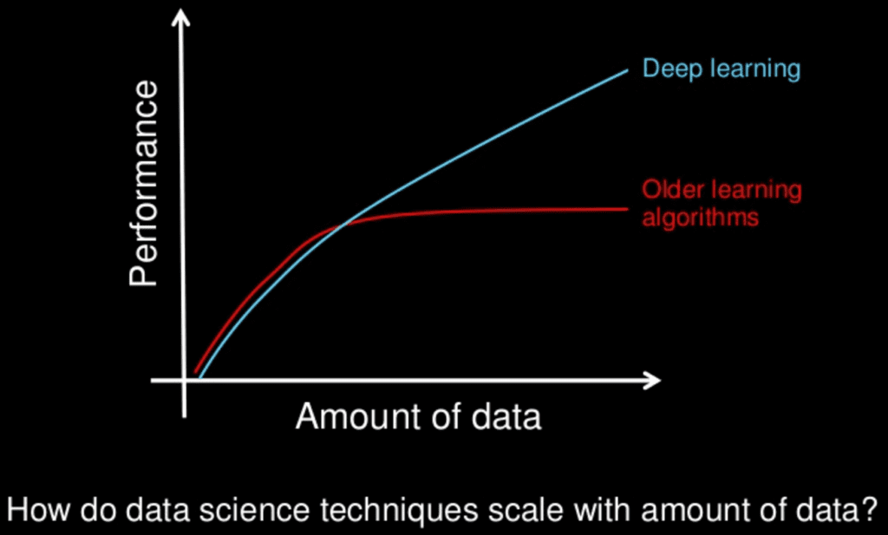
2006: Deep Learning (Rebranding)
Hinton once again declared he knew how brain works
He introduced: “Unsupervised Pretraining” and “Deep Belief Nets” – DBN
These technique could partially resolve the “vanishing gradient” problem.
Using this technique, people could train the NN that were deeper than previous attempt => rebranding to “Deep Learning”

Slide 20


2010: ImageNet
Feifei Li (a Stanford CS professor) and her group created the dataset named “ImageNet”
The “ImageNet” has millions of images with thousand of assigned labels
The project was supported by the booming of internet, digital cameras.
This dataset has been updated annually and used in the competition named: ImageNet Large Scale Visual Recognition Challenge (ILSVRC)
2010 & 2011: many teams participated in the competition, they used mostly SVM and the top models had error rates of 28% (2010) and 26% (2011)
14,197,122 images, 21841 synsets indexed

Slide 21
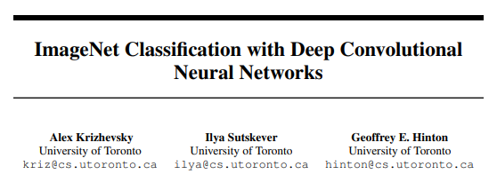
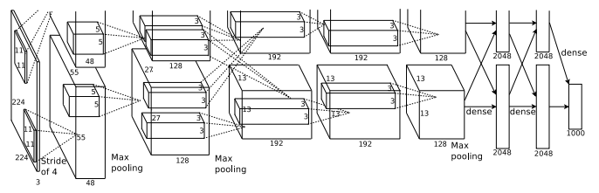
2012: Breakthrough
2012, Hinton and his student Alex Krizhevsky attended and got first prize in ILSVRC with error rate of 16% (!!!) that surprised the community: the born of Deep CNN or “AlexNet”
In this competition, there are few key contributions:
Introduction of Rectified Linear Activation function (ReLU) to partially overcome “vanishing gradient” and increase the computation speed
Introducing “Dropout” method to shutoff some unused unit, help to avoid Overfitting (Similar to Ensemble in ML)
AlexNet has great contribution from using GPUs that accelerated the computational speed from using CPUs

Slide 22
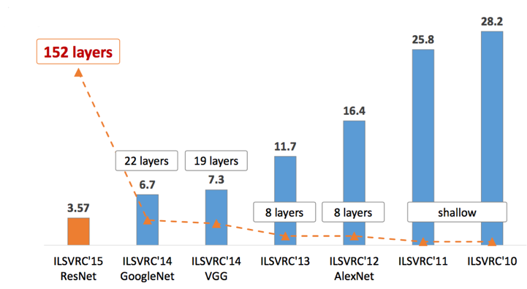
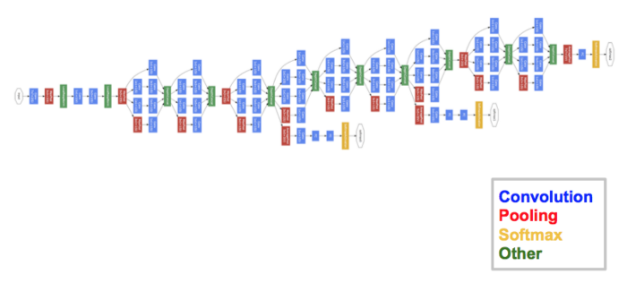
2013: Since then …
After AlexNet, deeper and deeper NN have been applied to ILSVRC
Increase in hidden layers => decrease error rate
Error rate decreases
GoogLeNet 2014

Slide 23
Discussions:
What brings up the success of Deep Learning?
New and new heavy datasets born with labels (e.g: ImageNet)
Ability of GPUs in parallel computing
More activation function to overcome vanishing gradient (ReLU), exploding gradient (Gradient clipping)
Contribution of tech company (GoogLeNet, ResNet,…) and other technology like transfer learning, finetuning
More and more regularization/ensemble technique to avoid overfitting: Dropout, Batch Normalization, Data Augmentation
More and more library (many developed by Tech Company): Tensorflow, Pytorch, …
New Optimization technique: Adam, RMSProp,…

Slide 24
What can SMU HPC help you with Deep Learning?
SMU M2 HPC features with
33 nodes equipped with 1 Tesla P100 GPU/node
5 nodes equipped with 8 Tesla V100 GPU/node
SuperPODS from NVIDIA with 20 nodes equipped with 8 A100 GPUs/node (available this summer)
High infiniband connection with nearly unlimited storage for your big data model

Slide 25
APPLICATIONS OF DEEP LEARNING
Notes:
Idea follow Vblog: machinelearningcoban and Deep Learning 101
Machine Learning cơ bản (machinelearningcoban.com)
Deep Learning 101 - Part 1: History and Background (beamandrew.github.io)

Slide 26
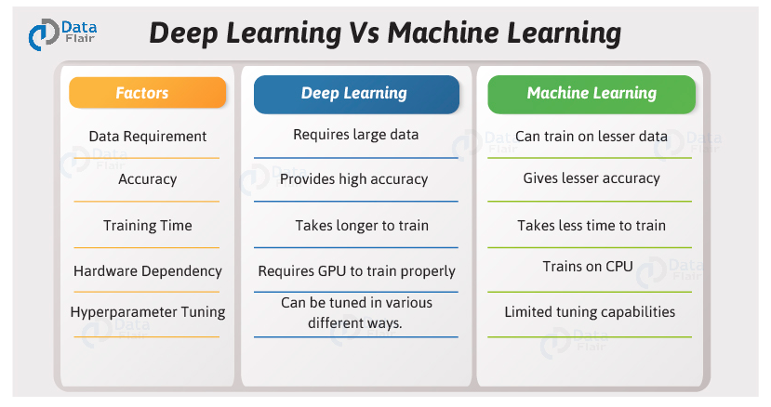

Slide 27
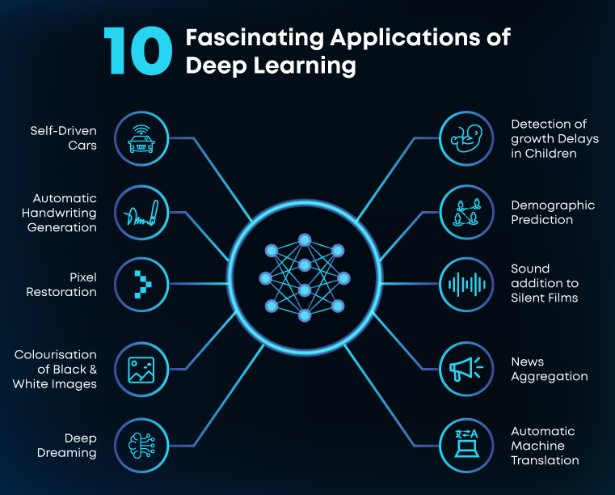

Slide 28
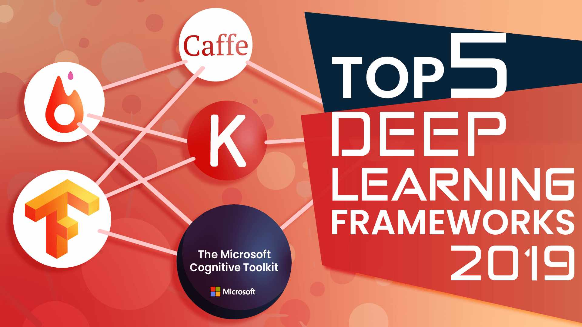
DEEP LEARNING FRAMEWORK
Notes:
Idea follow Vblog: machinelearningcoban and Deep Learning 101
Machine Learning cơ bản (machinelearningcoban.com)
Deep Learning 101 - Part 1: History and Background (beamandrew.github.io)

Slide 29
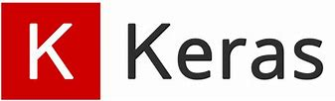
(1) Keras
Keras is an effective high-level neural network Application Programming Interface (API) written in Python. This open-source neural network library is designed to provide fast experimentation with deep neural networks, and it can run on top of CNTK, TensorFlow, and Theano.
Keras focuses on being modular, user-friendly, and extensible. It doesn’t handle low-level computations; instead, it hands them off to another library called the Backend.
Keras was adopted and integrated into TensorFlow in mid-2017. Users can access it via the tensorflow.keras module. However, the Keras library can still operate separately and independently.

Slide 30

(2) Tensorflow
TensorFlow is an end-to-end open-source deep learning framework developed by Google and released in 2015.
It is known for documentation and training support, scalable production and deployment options, multiple abstraction levels, and support for different platforms, such as Android.
TensorFlow is a symbolic math library used for neural networks and is best suited for dataflow programming across a range of tasks. It offers multiple abstraction levels for building and training models.

Slide 31


(3) Pytorch
Pytorch is a relatively new deep learning framework based on Lua Torch.
Developed by Facebook (Meta)’s AI research group and open-sourced on GitHub in 2017, it’s used for natural language processing applications.
Pytorch has a reputation for simplicity, ease of use, flexibility, efficient memory usage, and dynamic computational graphs. It also feels native, making coding more manageable and increasing processing speed.
Strong competitor to Tensorflow

Slide 32

(4) Theano
Theano used to be one of the more popular deep learning libraries, an open-source project that lets programmers define, evaluate, and optimize mathematical expressions, including multi-dimensional arrays and matrix-valued expressions.
Theano was developed by the Universite de Montreal in 2007 and is a key foundational library used for deep learning in Python. It’s considered the grandfather of deep learning frameworks and has fallen out of favor by most researchers outside academia.

Slide 33



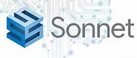
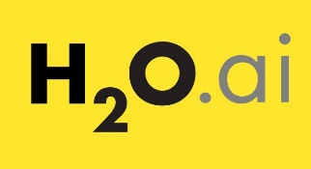
(5 and so on)
The number of Deep Learning framework is not just standing still, other tech giants are into the game:
Microsoft Cognitive Toolkit (CNTK) launched in 2017
Meta/FB launched Caffe2 as successor to the wellknown Caffe framework (developed by the Berkeley Vision and Learning Center)
Apache MXnet supported by Microsoft and Amazon and it supports many other languages including R (Yes R)
And many more: Sonnet (from Google DeepMind), H20.ai, Spark

Slide 34
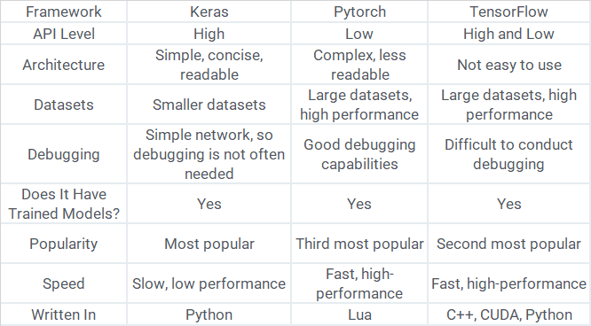
… in comparison

Slide 35
Conclusions:
Keras is the easiest Deep Learning Library API. It is easy to transit from scikit-learn based model
Tensorflow is the most popular DL library developed by Google. It has the most number of user.
Pytorch is developed by Facebook and gaining significant attention from users all over the world

Slide 36
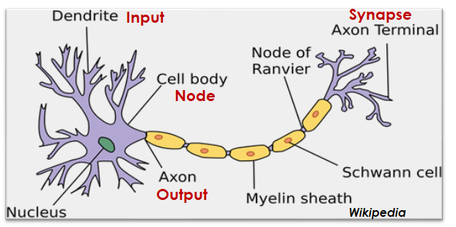
Recap on ANN: Biological Neural Network
Biological Neural Network
Notes:
Neural network is a series of algorithms that endeavors to recognize underlying relationships in a set of data through a process that mimics the way the human brain operates.
Neuron is a basic unit in a nervous system and is the most important component of the brain.
In each Neuron, there is a cell body (node), dendrite (input signal) and axon (output signal to other neuron).
If a Neuron received enough signal, it is then activated to decide whether or not it should transmitt the signal to other neuron or not.

Slide 37
Recap on ANN: Perceptron
wx > k: y=1
wx < k: y=0
x
y
Neuron

Slide 38
Recap on ANN: Perceptron
x1
w₁x₁+w₂x₂ > k: y=1
w₁x₁+w₂x₂ < k: y=0
y
x2
Neuron

Slide 39
Recap on ANN: Perceptron
x₁
Σw_{i}x_{i} + ci > K: y=1
Σw_{i}x_{i} + ci < K: y=0
y
x₂
Neuron
x_{n}

Slide 40
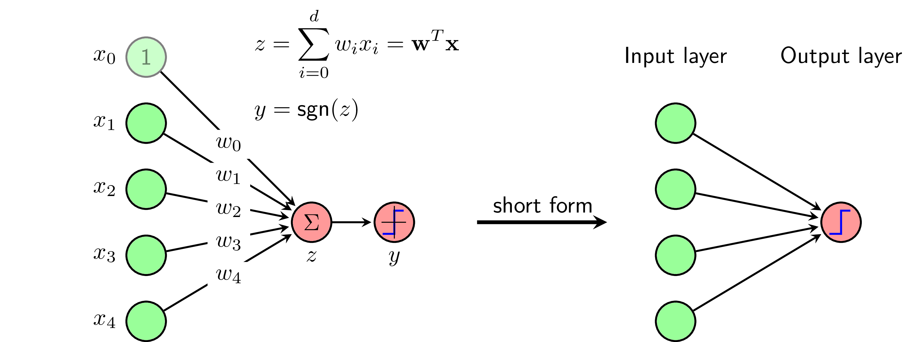
Recap on ANN: The first Neural Network
Note: Linear function cannot capture the Non-linearity
The sign activation function: the simplest form of Neural Network

Slide 41
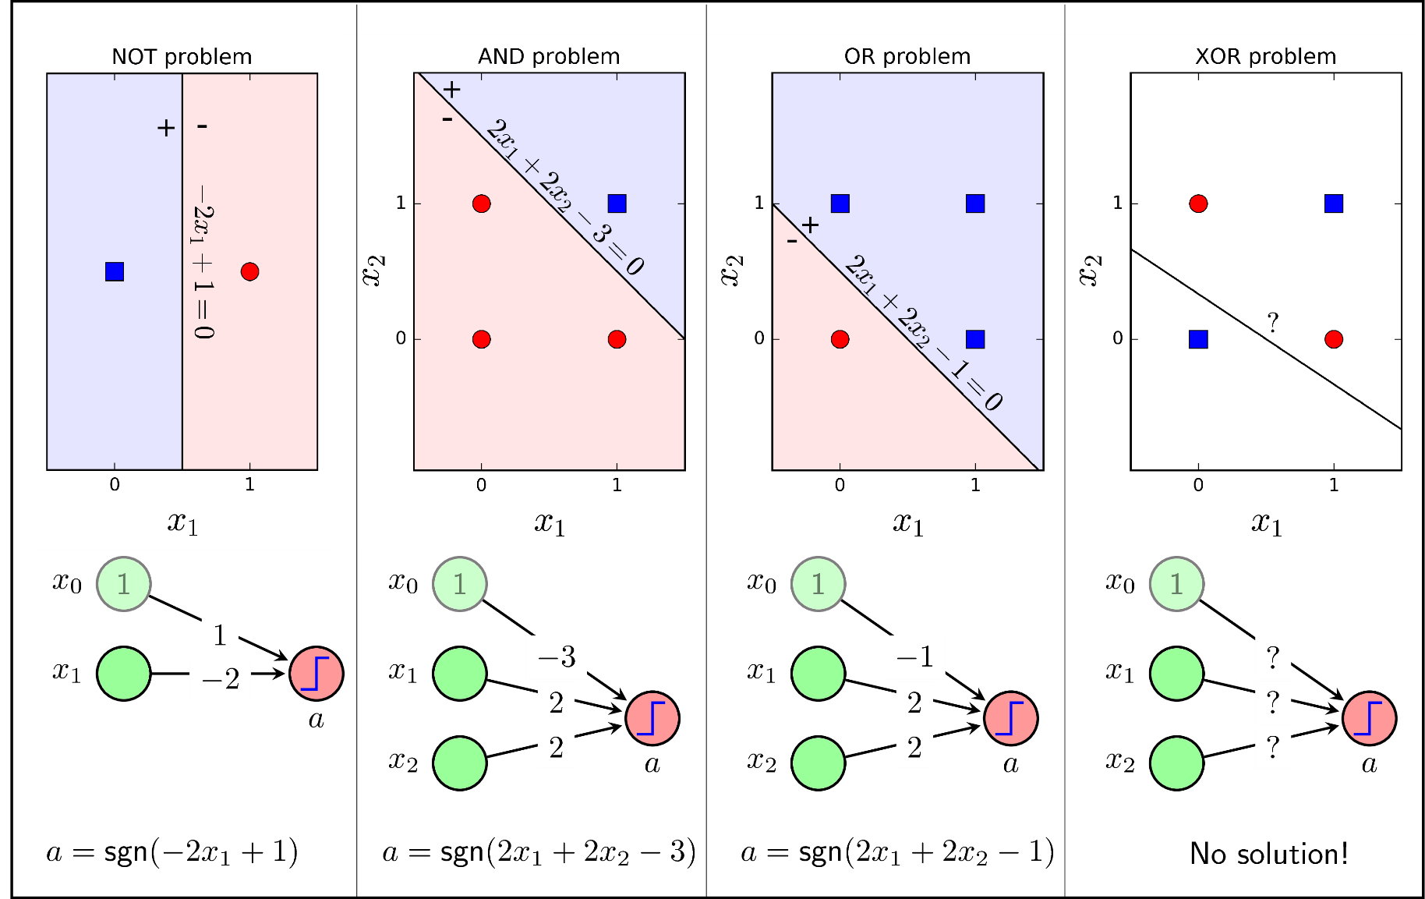
Recap on ANN: Multi-Layer Perceptron
The Perceptron Layer Algorithm works well for linear separable problem with AND, OR problem but not with nonlinear

Slide 42
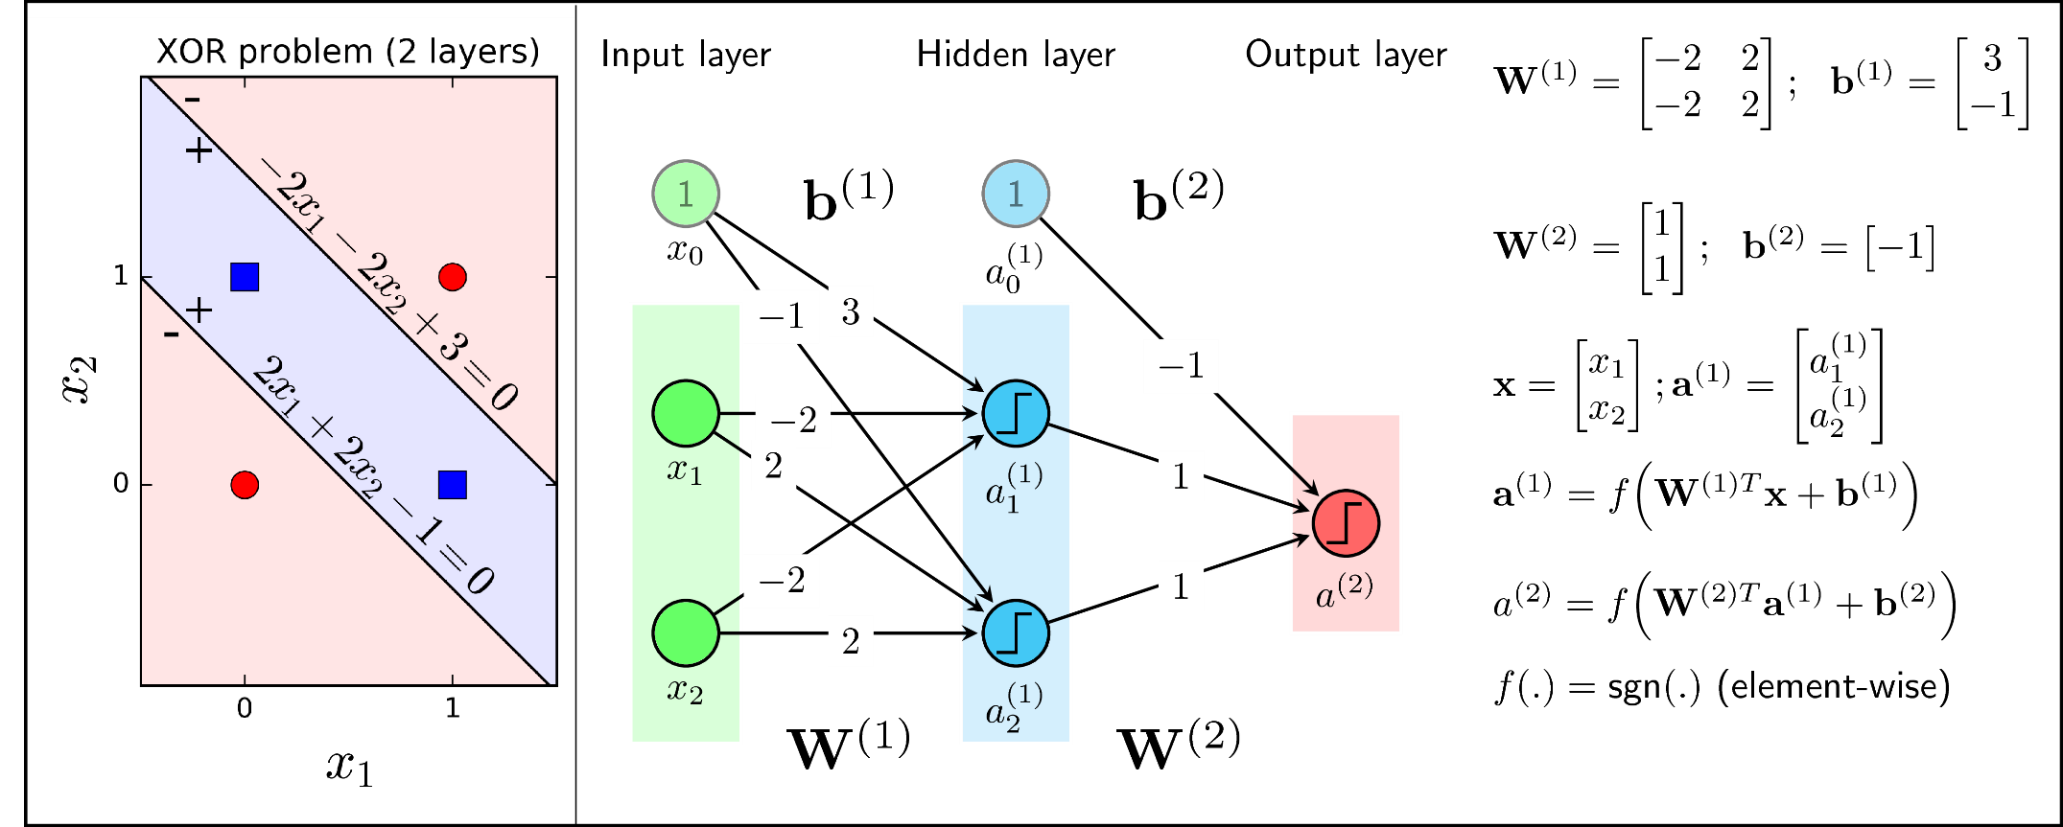
Recap on ANN: Multi-Layer Perceptron
For Nonlinear separable, one more layer should be added: hidden layer.
The Model is called Multi-Layer Perceptron

Slide 43
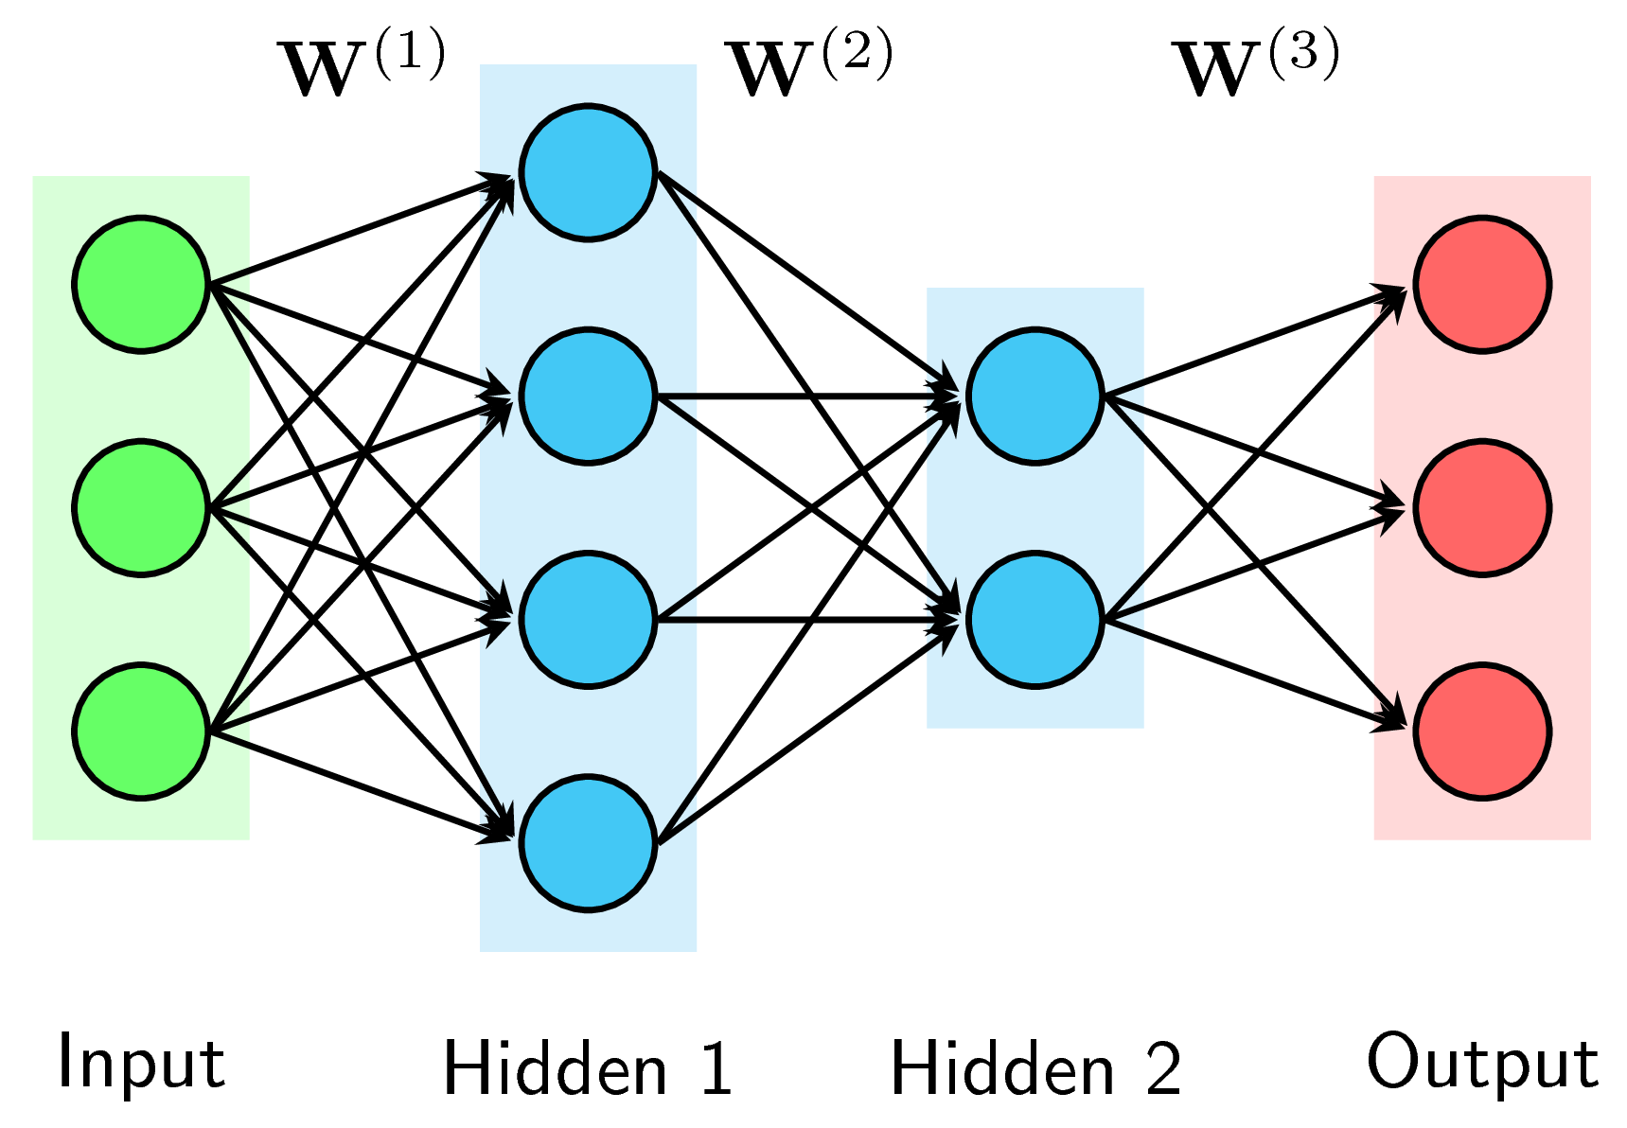
Recap on ANN: Multi-Layer Perceptron
MLP can have more hidden layers.
When you refer to the number of layers (L) of MLP, you should NOT count the input layers.
In the above figures: the L = 3

Slide 44
Recap on ANN: Multi-Layer Perceptron
Input Layer: The number of neurons in input layers equal to the input vector size
x₁
x₂
x_{n}

Slide 45
Recap on ANN: Multi-Layer Perceptron
Output Layer:
Classifier: The number of neurons in output layers equal to the number of categories
Regression: one or many neurons in output layers but the activation function needs to produce continuous values
y₁
y₂
y_{n}

Slide 46
Recap on ANN: Multi-Layer Perceptron
Hidden Layers:
Weights are updated

Slide 47
Recap on ANN: Multi-Layer Perceptron
hidden units
Input unit
output unit

Slide 48
Recap on ANN: Multi-Layer Perceptron
Weight
Bias

Slide 49
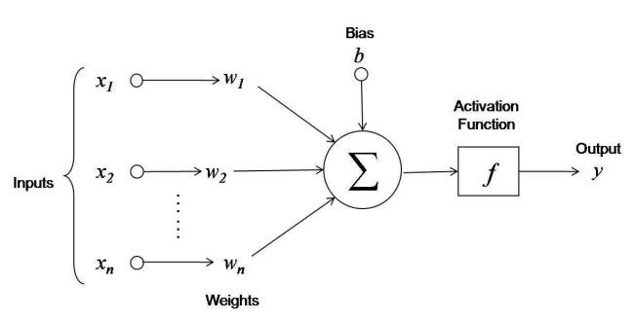
Recap on ANN: Activation functions

Slide 50
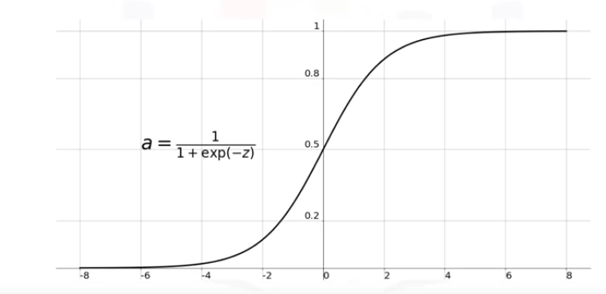
Recap on ANN: Activation functions
Sigmoid Function:
One of the widely used activation function in the hidden layer of NN
However, it is flat with abs(z)>3, therefore it might lead to “vanishing gradient” in Backpropagation approach, that slowdown the optimization of NN in Deep Neural Network.
Sigmoid function converts the output to range (0, 1) so it is not symmetric around the origin. All values are positive.
Application in binary classification problems.

Slide 51
Recap on ANN: Activation functions
Softmax
The softmax is a more generalised form of the sigmoid.
It is used in multi-class classification problems.
Similar to sigmoid, it produces values in the range of 0–1 therefore it is used as the final layer in classification models.
Application in classification with more categories

Slide 52
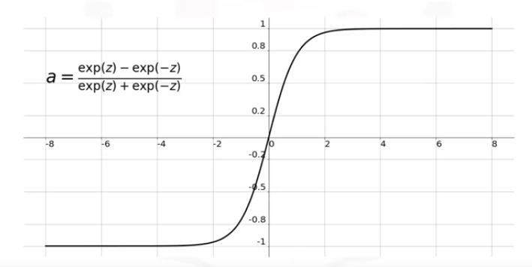
Recap on ANN: Activation functions
Hyperbolic Tangent (Tanh)
Tanh is quite similar to Sigmoid but it is symmetric around the origin
However, it also flat with abs(z)>3 and also lead to “vanishing gradient” problem in Deep Neural Network

Slide 53
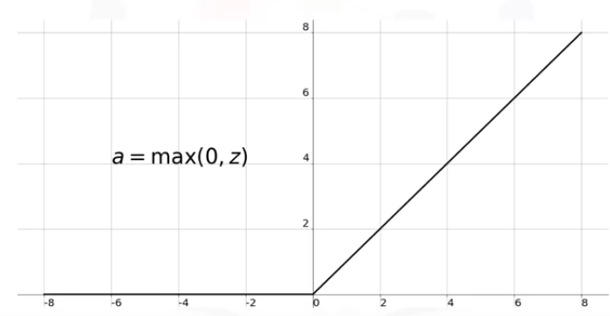
Recap on ANN: Activation functions
Rectangular Linear Unit (ReLU)
The most widely used Activation Function in Deep Neural Network
It is nonlinear
It does not activate all neuron at the same time: If the input is negative, the neuron is not activated
Therefore, it overcomes the “vanishing gradient” problem

Slide 54
Recap on ANN: Gradient Problems
Vanishing gradient
In a network of n hidden layers, n derivatives will be multiplied together. If the derivatives are small then the gradient will decrease exponentially as we propagate through the model until it eventually vanishes
The accumulation of small gradients results in a model that is incapable of learning meaningful insights since the weights and biases of the initial layers, which tends to learn the core features from the input data (X), will not be updated effectively. In the worst case scenario the gradient will be 0 which in turn will stop the network and stop further training.

Slide 55
Recap on ANN: Gradient Problems
Exploding gradient
If the derivatives are large then the gradient will increase exponentially as we propagate down the model until they eventually explode, and this is what we call the problem of exploding gradient
The accumulation of large derivatives results in the model being very unstable and incapable of effective learning, The large changes in the models weights creates a very unstable network, which at extreme values the weights become so large that is causes overflow resulting in NaN weight values of which can no longer be updated.

Slide 56
Recap on ANN: Gradient Problems
Solutions
Reduce the amount of layer
Proper weights for initilization

